Slide 1
Fraud & Legal: Third Party Legal Claims
- TEAM LEGALX

Slide 2
Team Members
Mohd. Altaf Khan | 2024 | VIT Chennai
Kesav Santhosh | 2024 | VIT Chennai
Harshenee CB | 2024 | VIT Chennai
A Venkata Vignesh Reddy | 2024 | VIT Chennai
M Rokithkumar | 2024 | VIT Chennai

Slide 3
Problem Statement
Preparing written declarations, objections, interlocutory petitions, and written notes of arguments with input on defenses takes a significant amount of time, causing delays and jeopardizing the defense before the court. Reading and manually searching Indian and international decisions, citations, research, case studies, papers on law, and accessible evidence in cases takes a significant amount of time. Proper and effective repudiation letters based on facts and law that would stand up in court if disputed are a big problem.

Slide 4
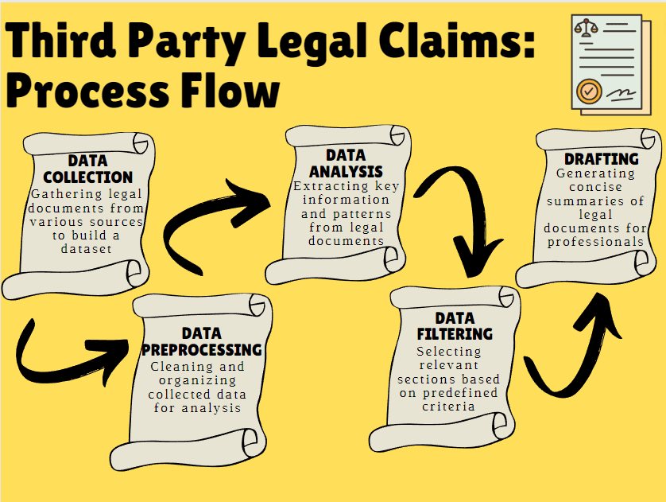
Process Flow

Slide 5
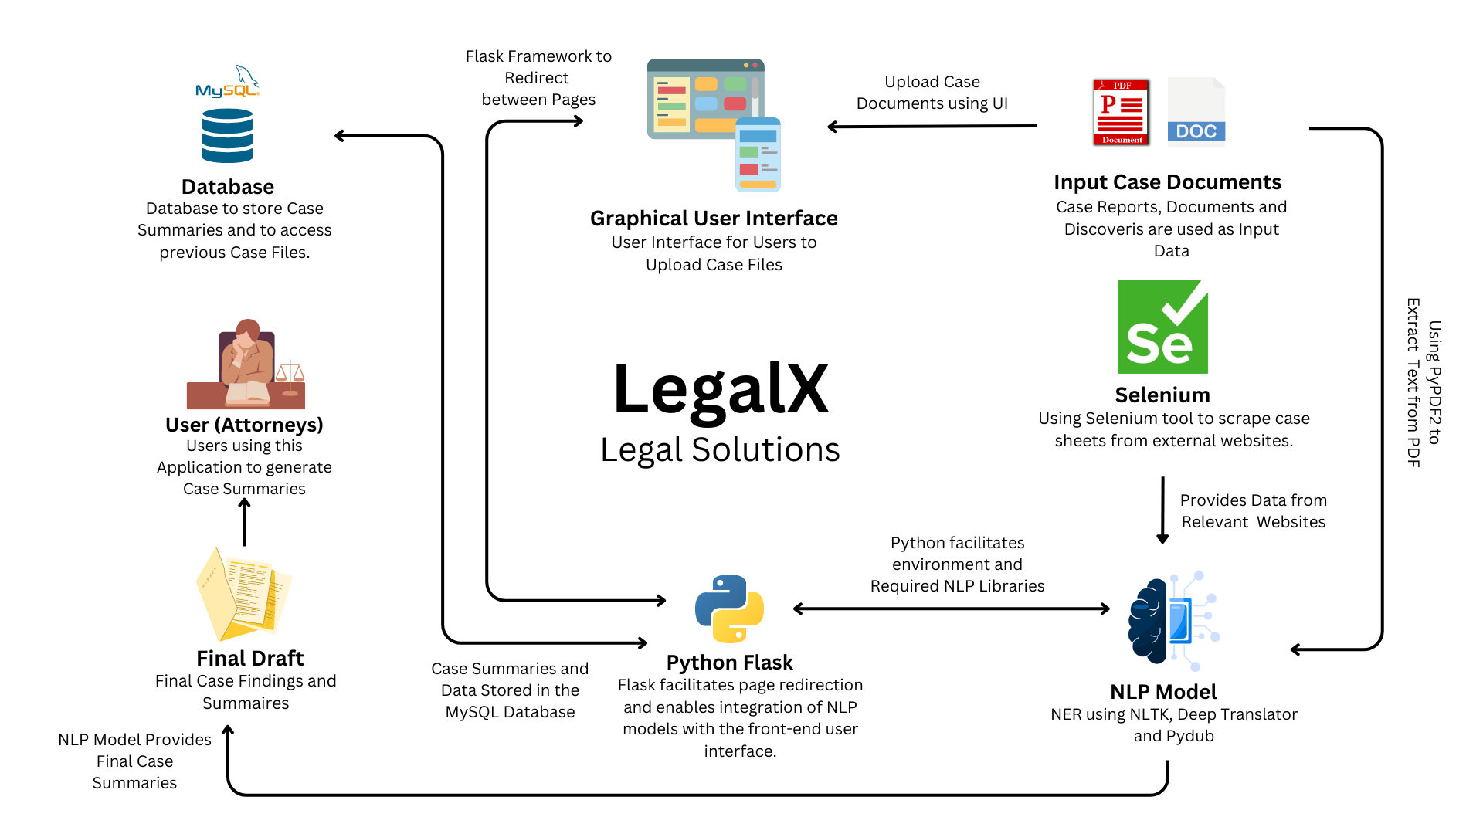
Solution Architecture

Slide 6
Overview of our solution
In recent times, the legal landscape has witnessed an unsettling rise in false third-party legal claims, which poses a significant challenge to the justice system and adversely impacts individuals, businesses, and society at large.
The insurance company have to make sure that all the policies being true. Creating the final draft is time consuming task as the format is almost similar for all the cases and there are many conditions in which the final verdict is same.
Our aim is to develop a solution to prepare the draft so that the insurance company could easily check the draft and verify whether the claim is valid or not. We are using Machine Learning and NLP models to automatically generate case drafts.

Slide 7
How is our solution different?

Slide 8
How is our solution different?
1) Different types of data-
Legal claims often involve various types of evidence, including written documents, audio recordings, and images. Allowing different file formats ensures that all relevant evidence can be submitted and considered during the claim drafting process. This comprehensive inclusion helps in presenting a more complete and accurate representation of the case.
The audio recordings and images can be converted into text. Then the text can be pre-processed, and drafts can be generated using the same.
The audio recordings can be converted to texts using pydub library and google speech recognition function and pytesseract library can be used to convert images to text.

Slide 9
How is our solution different?
2) Legal Knowledge-Base
A legal knowledge base offers centralized access to legal information, enabling professionals and the public to understand legal concepts and resources. A comprehensive legal knowledge base saves time and costs by enabling professionals to quickly access relevant information.
This system will help the lawyer to search for any complex legal jargon feature during the study of the draft. The Legal Knowledge-Base System allows us to keep the extracted information into separate categories, subcategories and topics.

Slide 10
UI Screenshots

Slide 11
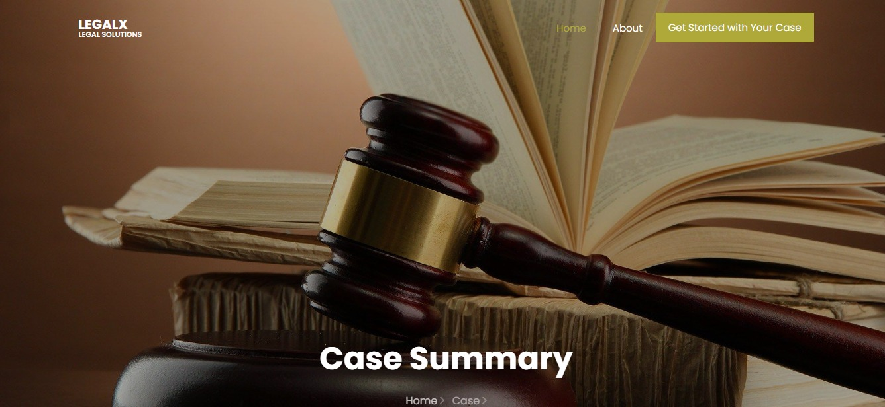
Index Page

Slide 12
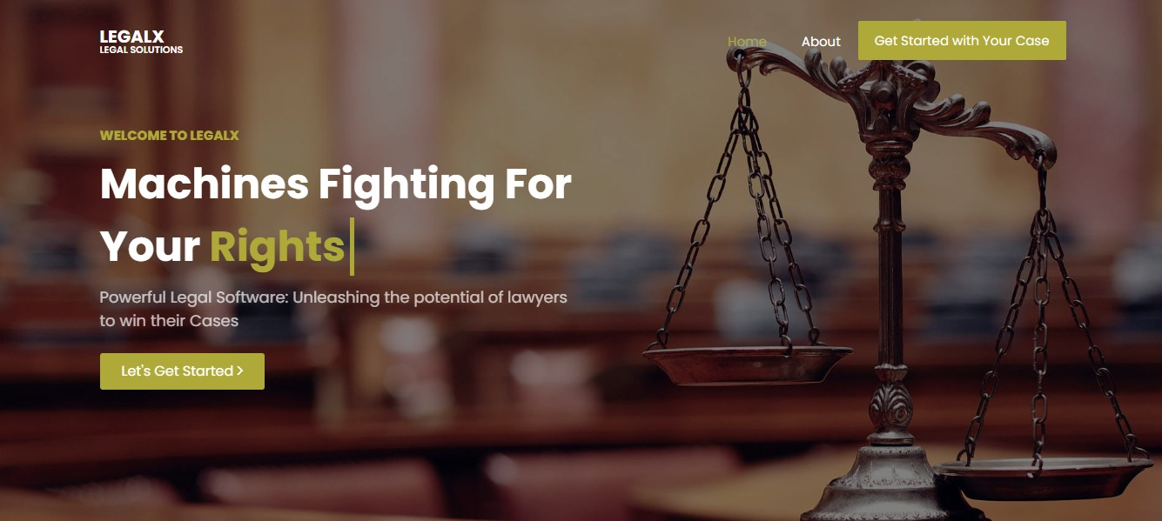
Input Page

Slide 13
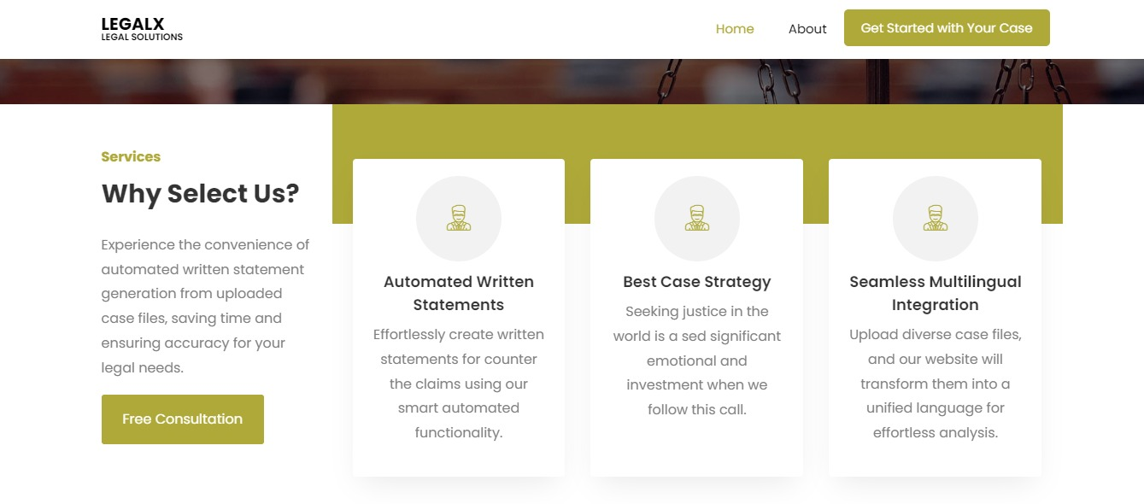
Upload Page

Slide 14
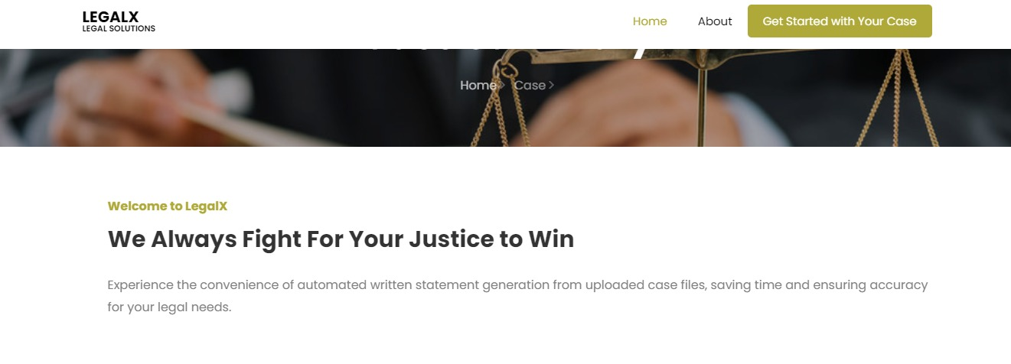
About Page

Slide 15
Risks/ Challenges/ Dependencies

Slide 16
Risks/ Challenges/ Dependencies
Document and Evidence Management:
Effective legal claims management requires accurate indexing, retrieval, and maintenance of large volumes of documents, preventing errors and oversight.
Content Variability:
Texts can vary significantly in terms of domain, genre, language style, and length. The system should be adaptable enough to handle different types of content effectively. Ensuring that the system performs well across diverse text sources can be a challenge.
Document and Evidence Management:
Effective legal claims management requires accurate indexing, retrieval, and maintenance of large volumes of documents, preventing errors and oversight.

Slide 17
Risks/ Challenges/ Dependencies
Context Understanding: Texts often contain references to previous information or contextual cues that help in understanding the cases fully. Ensuring that the system accurately captures and utilizes the relevant context is a challenge. In some cases, the system may generate summaries that are disconnected from the overall context.
Scalability: Scalability is crucial for websites with high traffic or complex functionalities. Flask's simplicity helps, but potential bottlenecks like database performance, caching, and load balancing must be addressed.

Slide 18
THANK YOU

